Slide 1
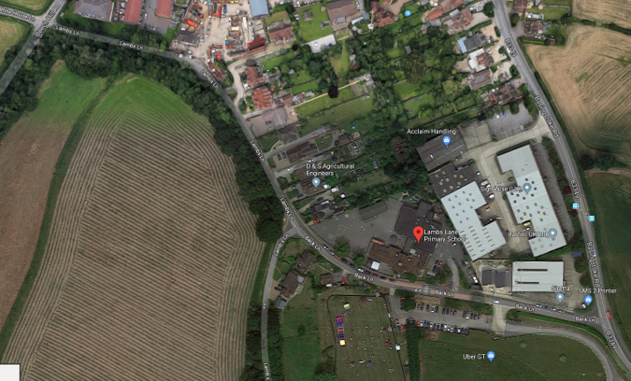
Lambs Lane School Unofficial One Way System
Enter from Beech Hill to drop off.
Enter from Basingstoke Road to use the carpark.
Drop off here.
Exit the car park here and turn right towards Basingstoke Road.
Enter the car park here from Basingstoke Road.

