Slide 1
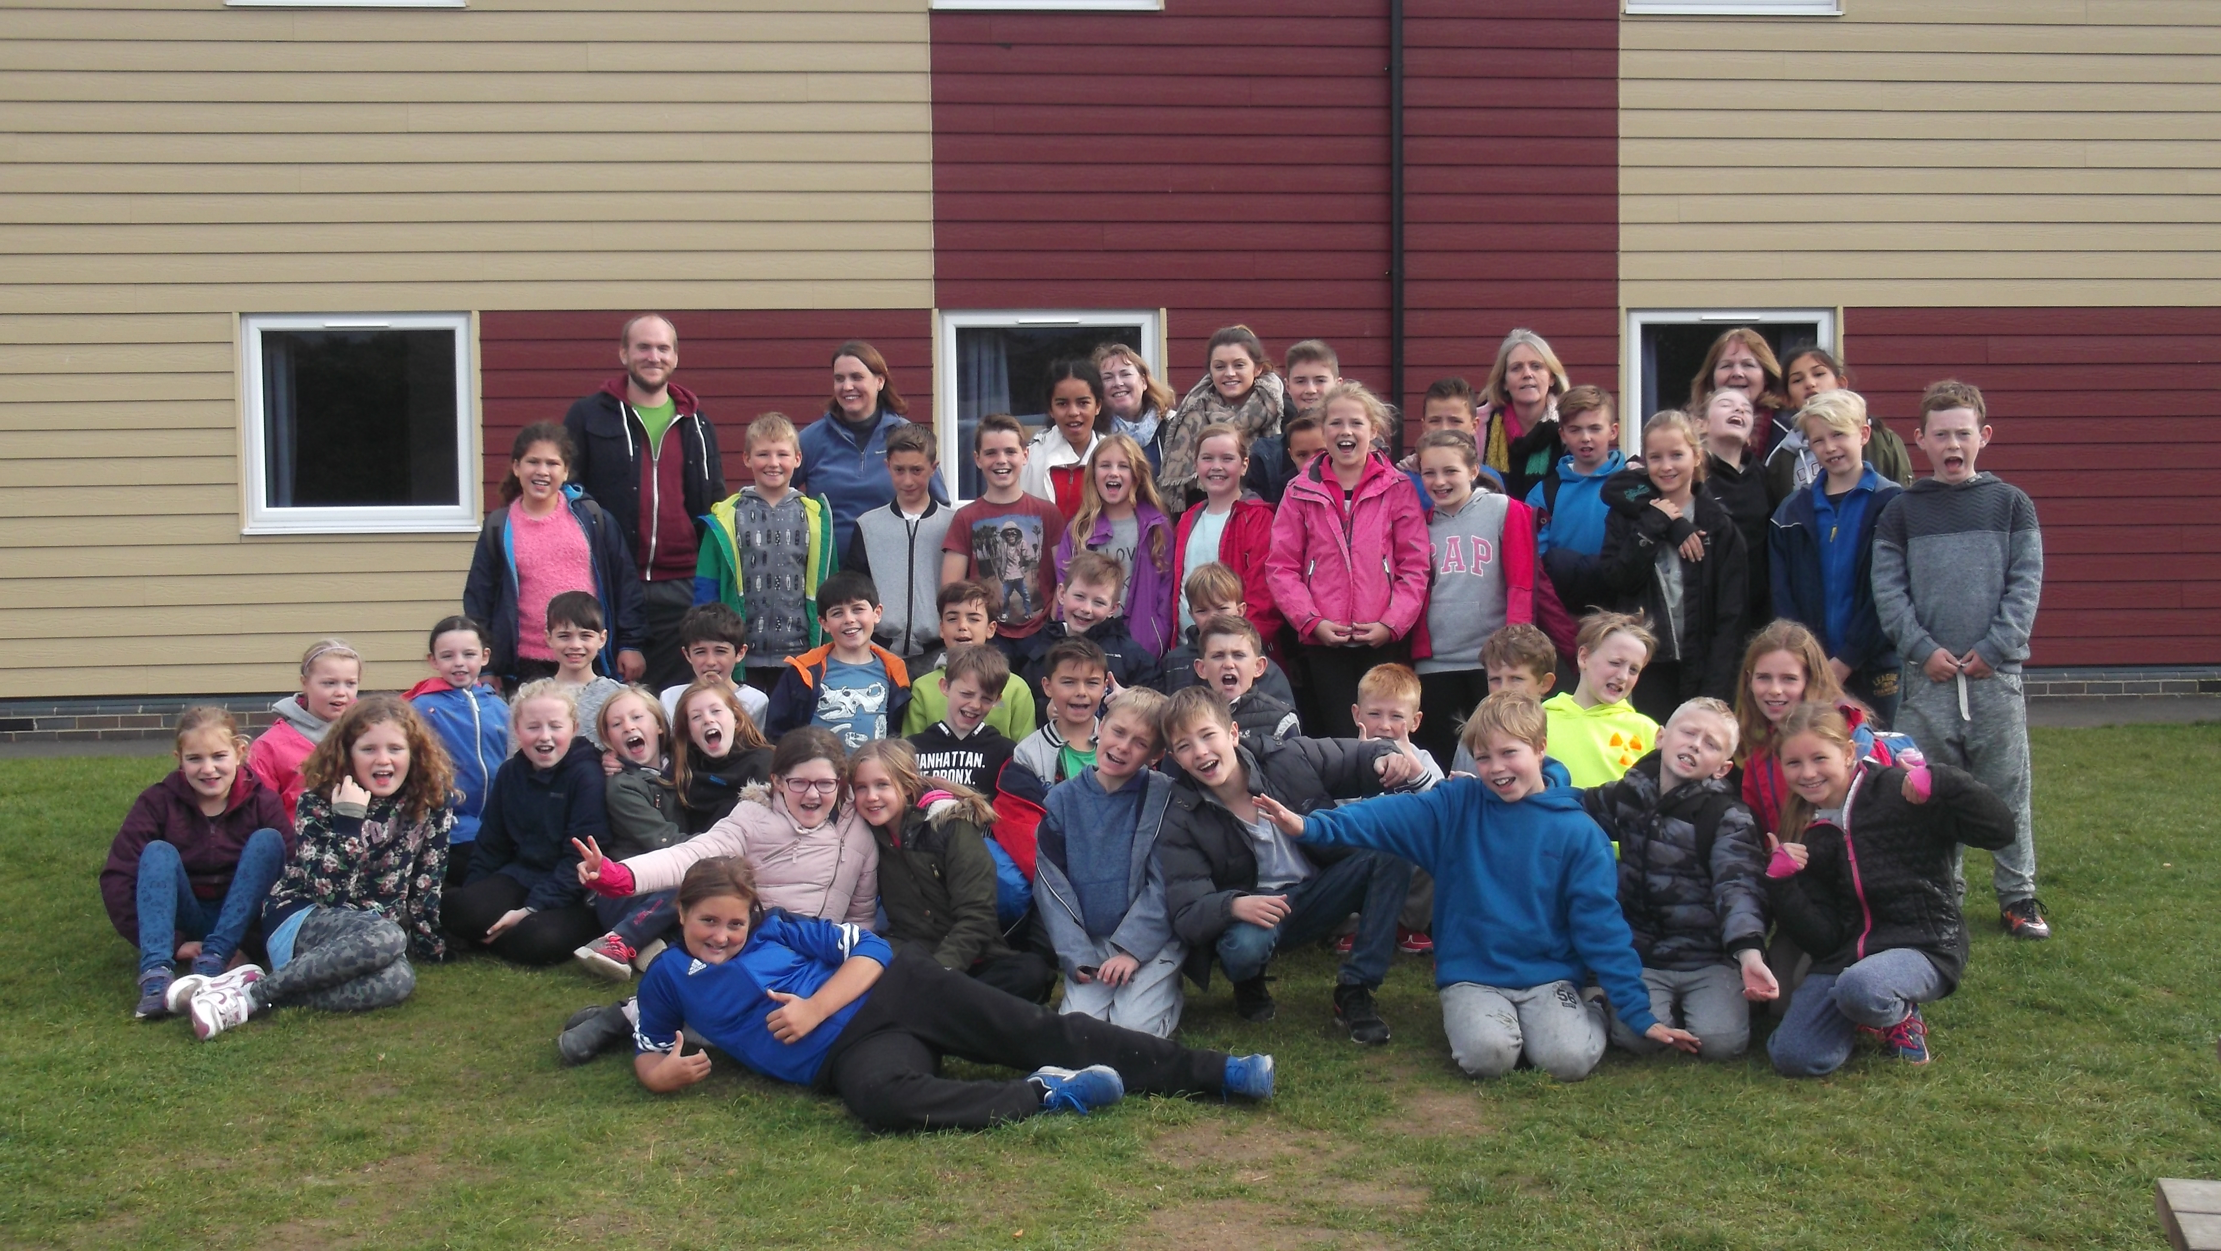
PGL Year 5/6 Residential Trip

Slide 2
Purpose
To combine learning and fun for excellence and enjoyment
To give pupils access to new opportunities
To develop social skills, life skills, PSHE, relationships and independence

Slide 3
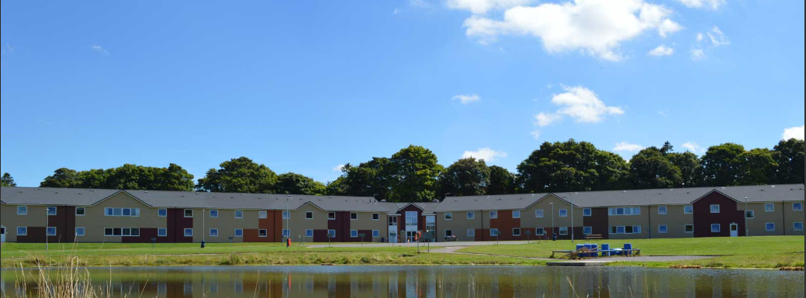
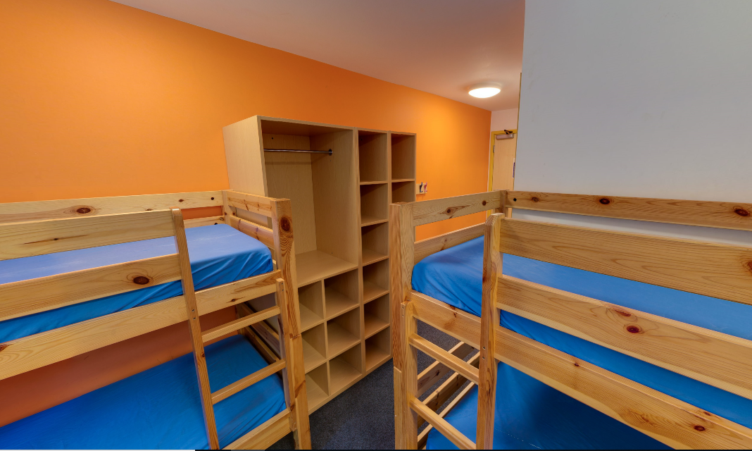
Accommodation
Children sleep in rooms of 4-6
Bring own bedding
(They will have at least 1 friend in their room.)
Ensuite bathroom in each room
Teacher rooms nearby

Slide 4
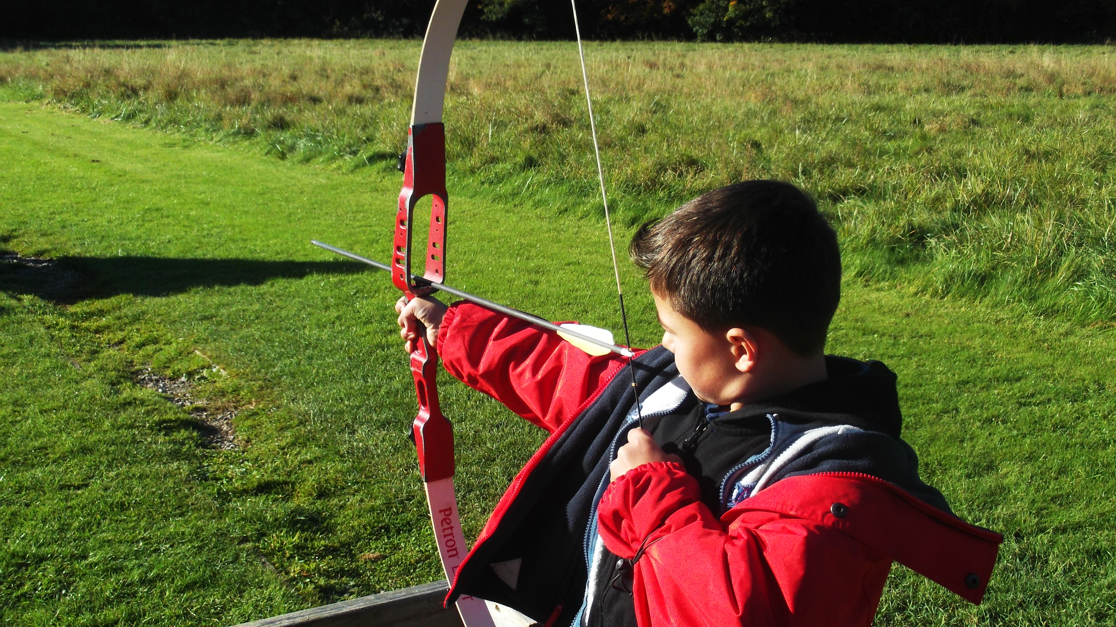
Typical Day
7:30 Wake up / showers / Room inspection
8:45 Breakfast
9:25 Activity 1 - Archery
11:05 Activity 2 - Problem solving
1:00pm Lunch
14:30 Activity 3 – Crate Challenge
16:10 Activity 4 – Zip wire
17:30 Free time
18:30 Dinner - together in dining room
Evening Activity – e.g. Robot Wars
Hot chocolate, story & bedtime

Slide 5
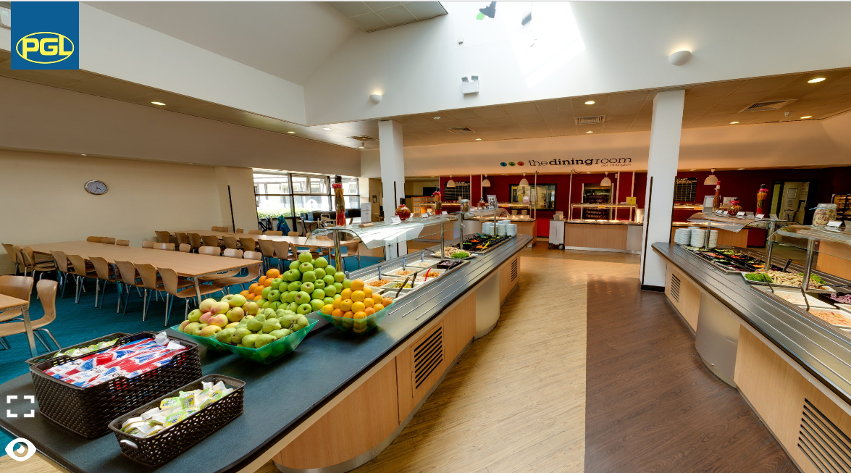
Meal times
Breakfast – cooked, toast, cereal
Always a choice of meal (3 options) – lunch & dinner
Salad bar available
Access to fruit & bread
Puddings

Slide 6
This year
Bring everything in Friday morning by 10:30am.
Arrival around lunchtime – need a disposable packed lunch.
We will have an afternoon activity then time to settle in to rooms, make beds, free time.
Dinner and an evening activity.
Saturday and Sunday are a typical day. We will be split into 4 groups of 12.
Monday morning will be typical with 2 activities.
Lunch at PGL.
Leave PGL at 2pm. Should be back at school by 3:30pm.

Slide 7
Kit List
Light Waterproof Jacket and sunhat/cap (check weather!)
Slippers/indoor trainers
Additional trainers/swim shoes for water activities (not crocs)
Sleepwear
Adequate clothing for 4 days in the outdoors – layers are good
Carrier bag/ bin bag for dirty clothing
Personal medication e.g. inhalers (Will be given to adults)
Toiletries, including sun cream and 2 towels
Book, suitable small game and 1 teddy or similar
Bedding – sleeping bag/ duvet and pillow

Slide 8
Staff
Mrs Meikle
Mrs French
Mrs Rose
Mrs Rowles
Mrs Lainsbury
Miss Brown

Slide 9
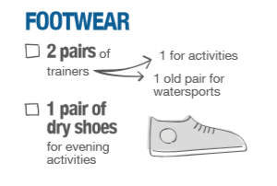
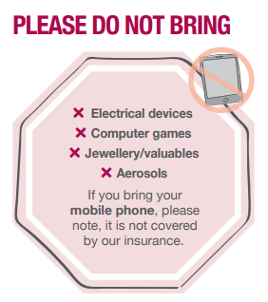
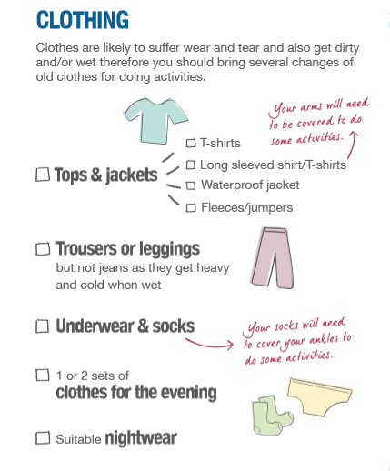
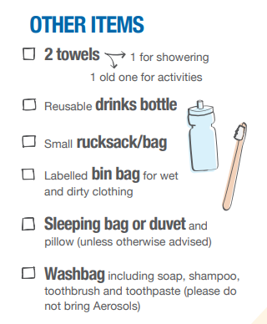

Slide 10
For more details , please look on the website:
https://www.pgl.co.uk/en-gb/adventure-holidays/centres/liddington

